Slide 1
Heart Disease Prediction
A136
Alan Lee
Alicia Lam
Jared Choa

Slide 2
TABLE OF CONTENTS
01
04
02
05
03
INTRODUCTION
MODELS USED
PROBLEM STATEMENT
CONCLUSIONS
EXPLORATORY DATA ANALYSIS

Slide 3
Introduction

Slide 4
Problem Definition
Which model is the most accurate?
Which indicator is best to predict heart disease?
Decision Tree
Random Forest
XG Boost
Age
Sex
Chest Pain Type
Resting Blod Pressure
Cholestrol
Fasting Blood Sugar
Max HR
Exercise Angina

Slide 5
EXPLORATORY
DATA
ANALYSIS

Slide 6
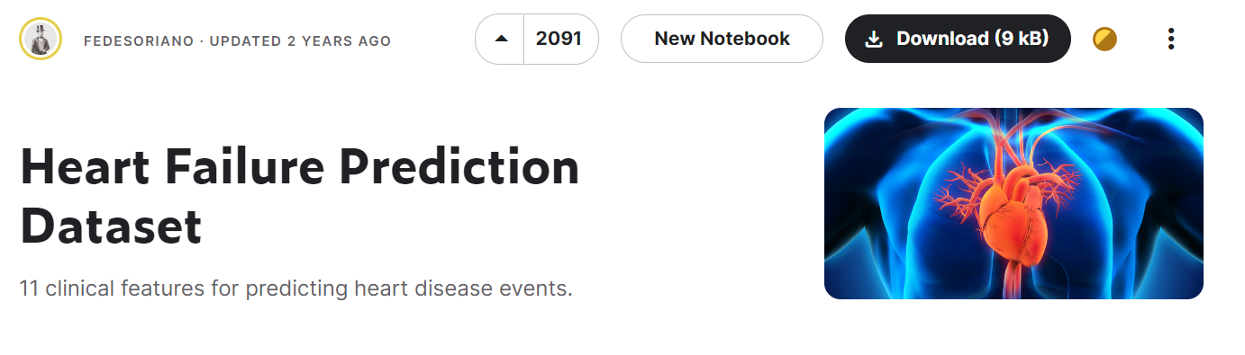
Notes:
https://www.endtoend.ai/tutorial/how-to-download-kaggle-datasets-on-ubuntu/

Slide 7
DATASETS USED (11 common features)
CLEVELAND
HUNGARIAN
SWITZERLAND
303 Observations
294 Observations
123 Observations
Long Beach
Stalog Dataset
200 Observations
270 Observations
Notes:
This dataset was created by combining different datasets already available independently but not combined before. In this dataset, 5 heart datasets are combined over 11 common features which makes it the largest heart disease dataset available so far for research purposes. The five datasets used for its curation are:
Cleveland: 303 observations
Hungarian: 294 observations
Switzerland: 123 observations
Long Beach VA: 200 observations
Stalog (Heart) Data Set: 270 observations
Total: 1190 observations Duplicated: 272 observations
Final dataset: 918 observations
Every dataset used can be found under the Index of heart disease datasets from UCI Machine Learning Repository on the following link: https://archive.ics.uci.edu/ml/machine-learning-databases/heart-disease/

Slide 8
1190 - 272
Total observations - Duplicates

Slide 9
918 Observations

Slide 10
EDA overview
01 | IRREGULARITIES
 | REMOVE | NULL or Duplicate data
02 | DATA ANALYSIS
 | RECOGNISE | Patterns or Correlations
03 | DATA PREPARATION
 | CURATION | Making sure our data is suitable for ML

Slide 11
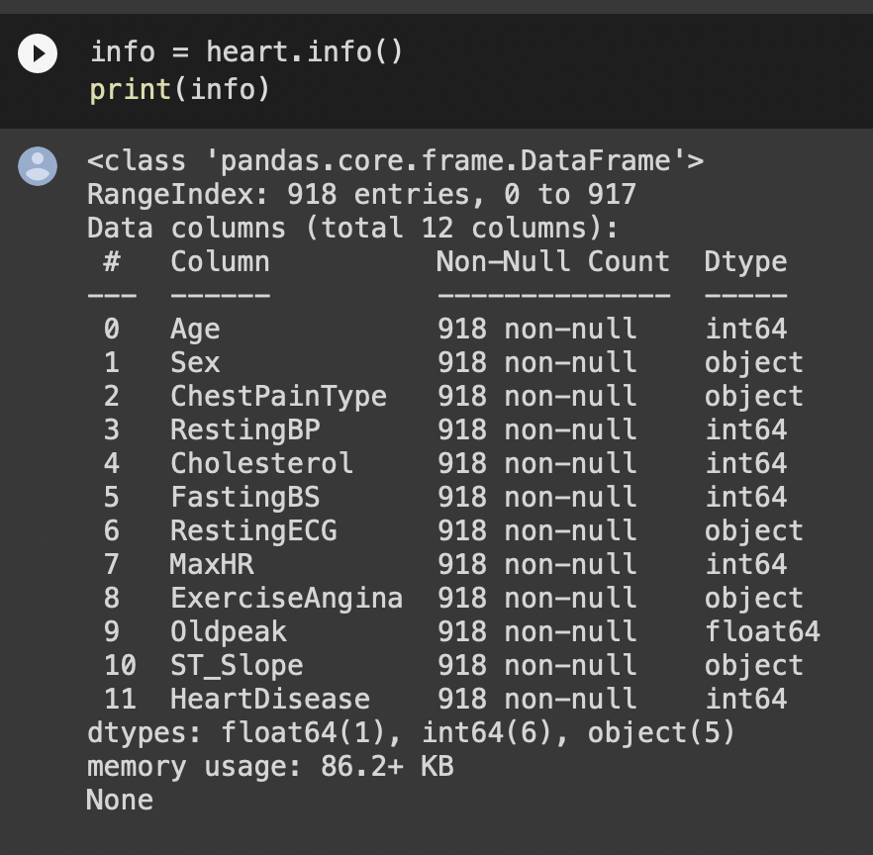
CHECK FOR MISSING DATA
Notes:
https://www.endtoend.ai/tutorial/how-to-download-kaggle-datasets-on-ubuntu/

Slide 12
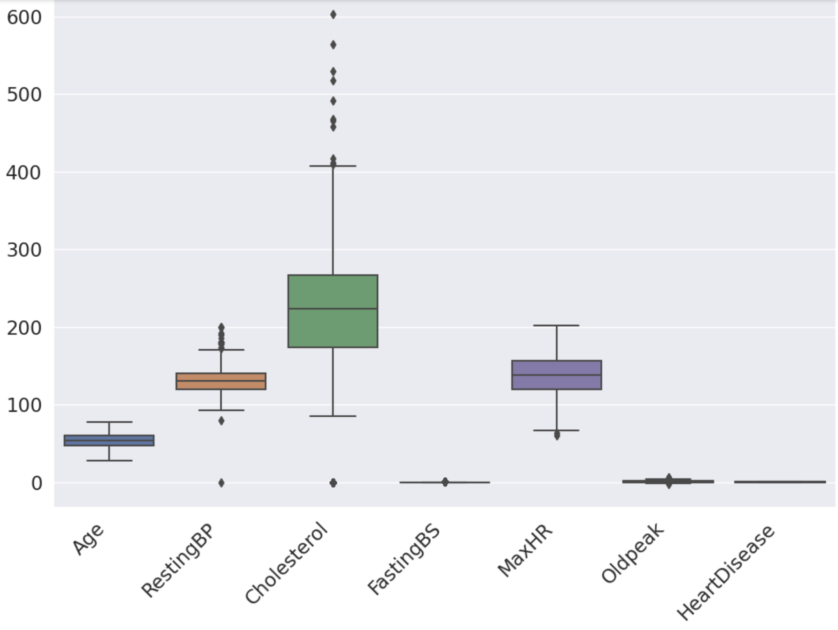
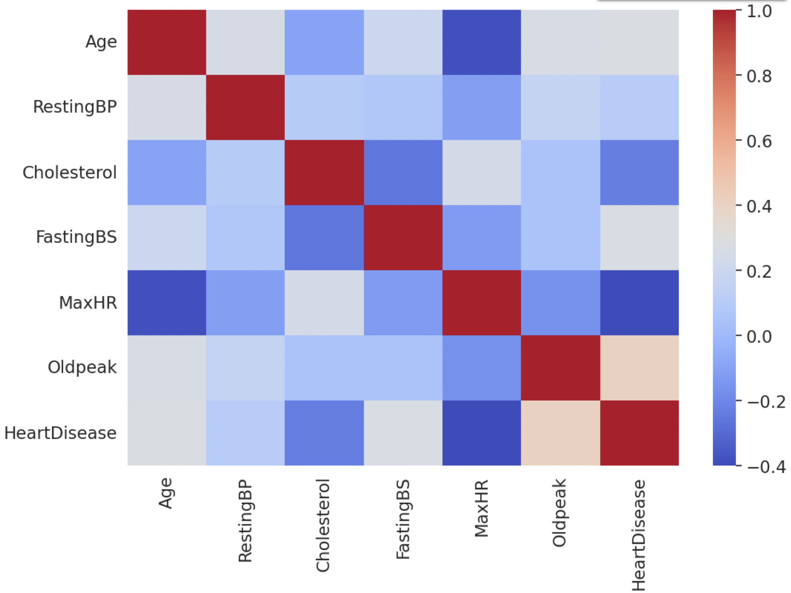
REMOVING IRREGULARITIES?
Notes:
https://www.endtoend.ai/tutorial/how-to-download-kaggle-datasets-on-ubuntu/

Slide 13
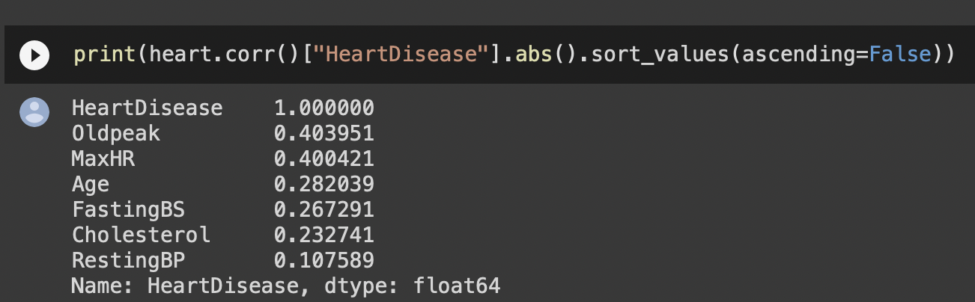
CORRELATION
Notes:
https://www.endtoend.ai/tutorial/how-to-download-kaggle-datasets-on-ubuntu/

Slide 14
EXPLORING
CATEGORICAL DATA

Slide 15
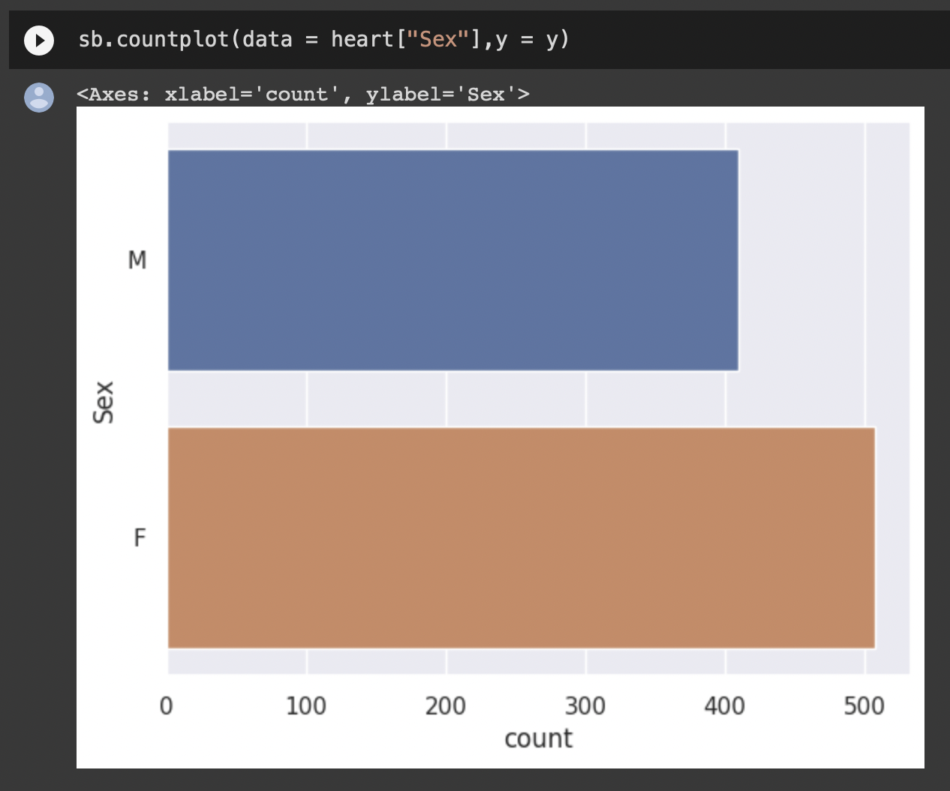
ANALYSING SEX FEATURE
Notes:
https://www.endtoend.ai/tutorial/how-to-download-kaggle-datasets-on-ubuntu/

Slide 16
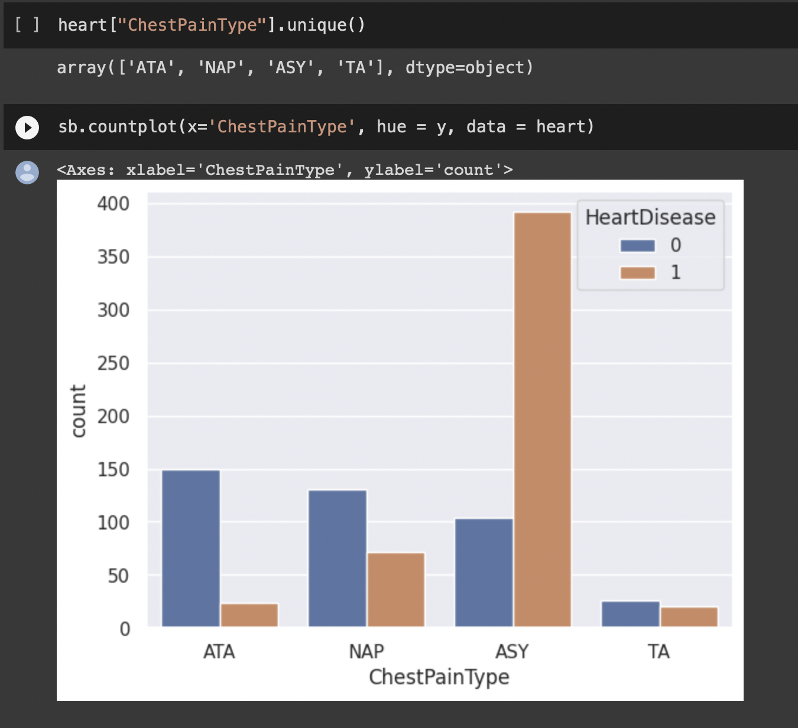
ANALYSING CHEST PAIN TYPE FEATURE
Notes:
https://www.endtoend.ai/tutorial/how-to-download-kaggle-datasets-on-ubuntu/

Slide 17
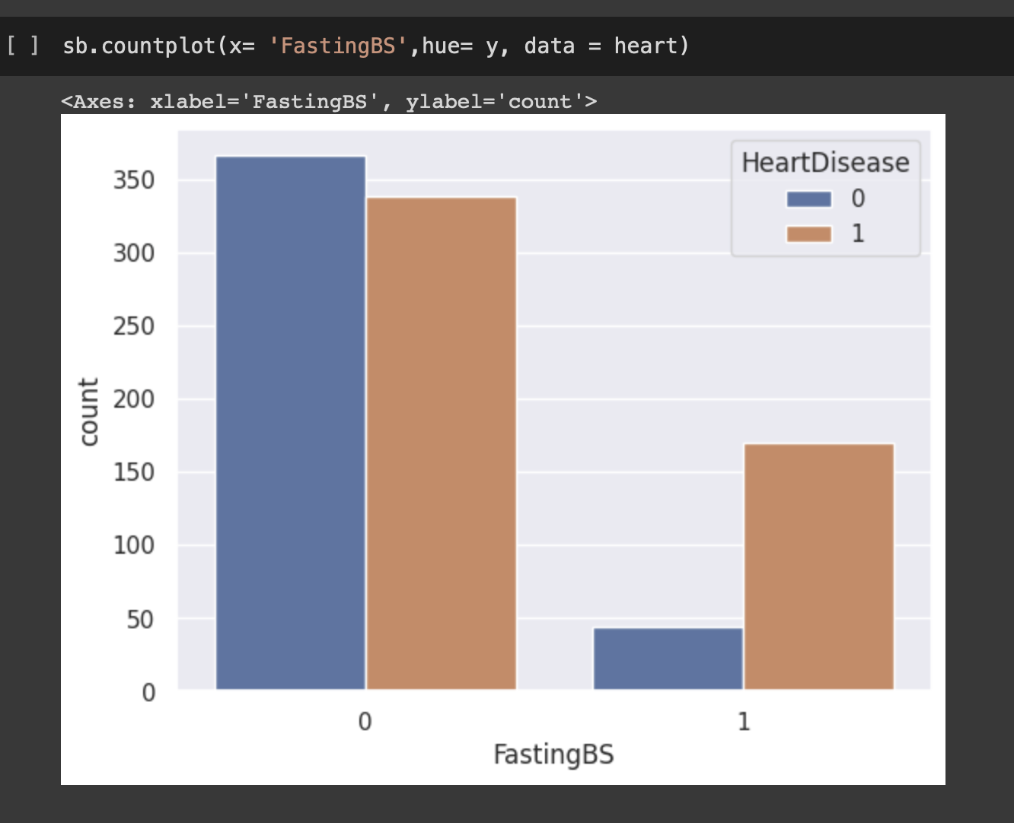
ANALYSING FASTING BS
Notes:
https://www.endtoend.ai/tutorial/how-to-download-kaggle-datasets-on-ubuntu/

Slide 18
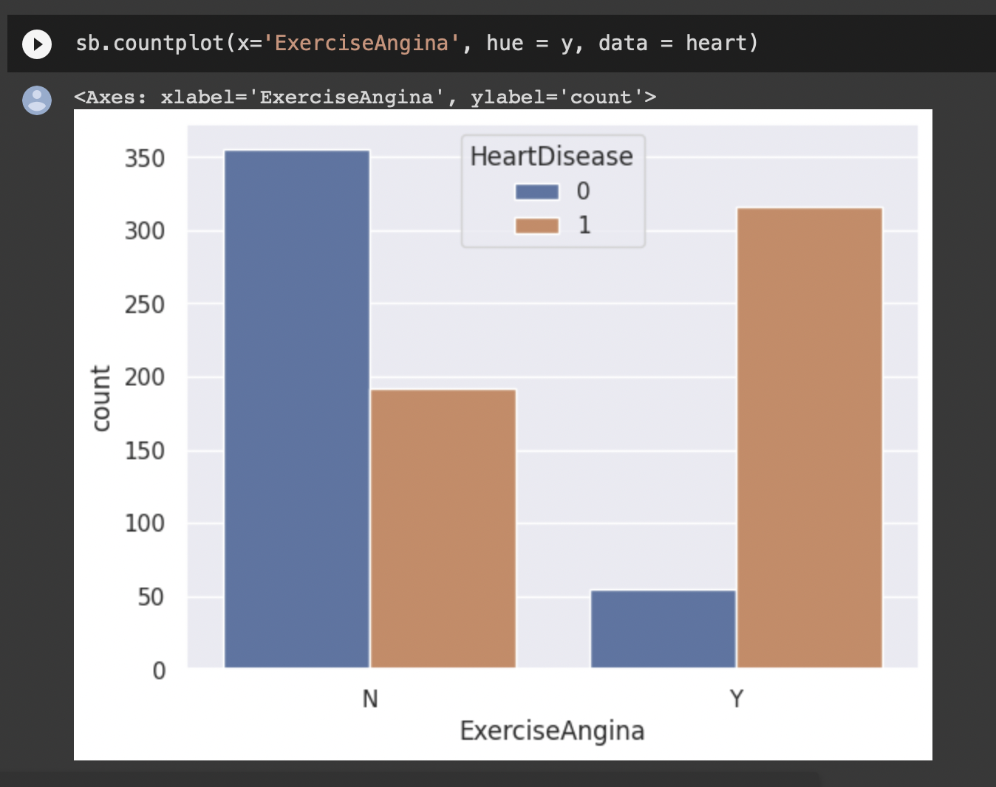
ANALYSING EXERCISE ANGINA
Notes:
https://www.endtoend.ai/tutorial/how-to-download-kaggle-datasets-on-ubuntu/

Slide 19
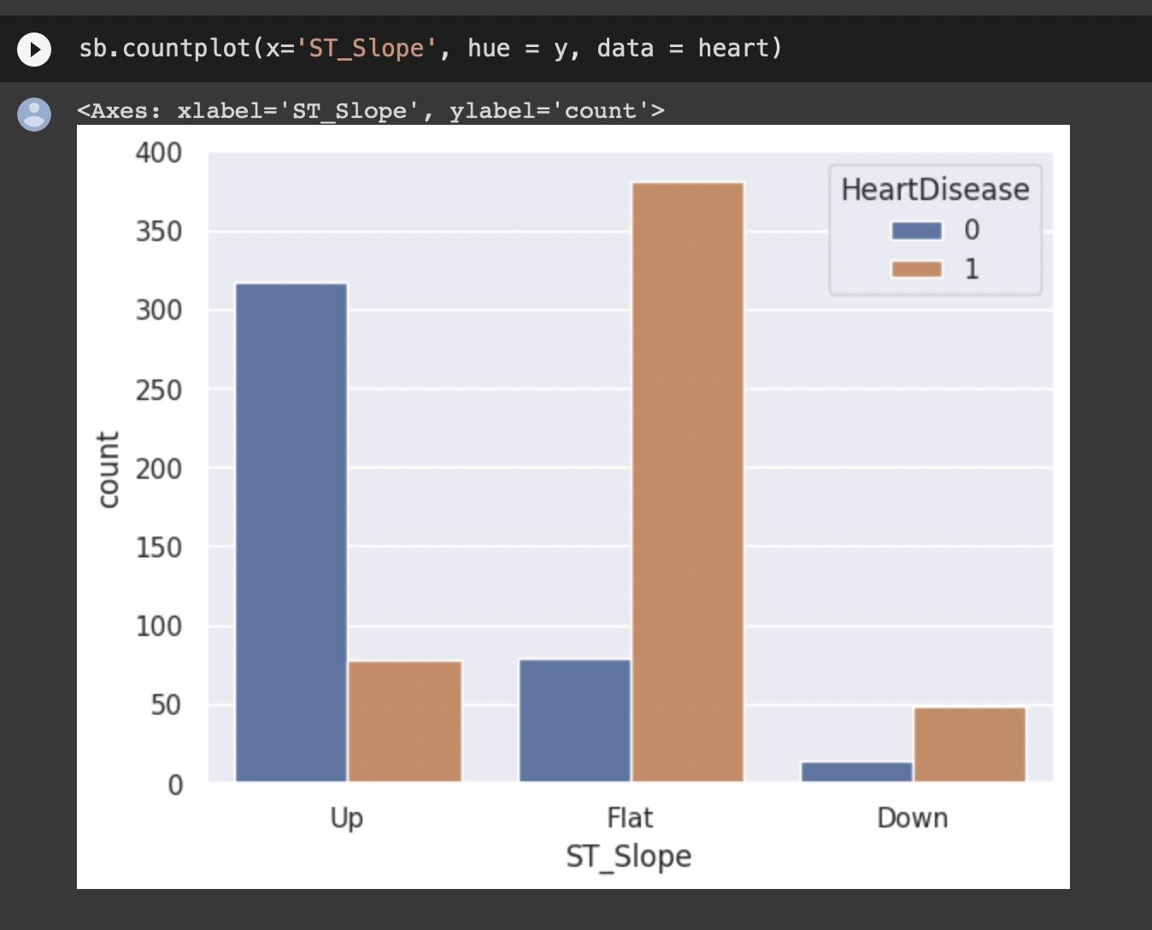
ANALYSING ST SLOPE
Notes:
https://www.endtoend.ai/tutorial/how-to-download-kaggle-datasets-on-ubuntu/

Slide 20
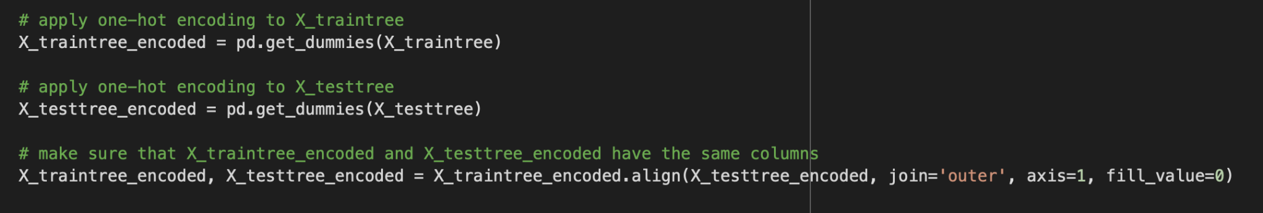
ENCODING DATA
CATEGORICAL DATA
NUMERICAL DATA
Notes:
https://www.endtoend.ai/tutorial/how-to-download-kaggle-datasets-on-ubuntu/
we convert each categorical value into a new categorical column and assign a binary value of 1 or 0 to those columns. Each integer value is represented as a binary vector. All the values are zero, and the index is marked with a 1.

Slide 21
ONE HOT ENCODING
CATEGORICAL DATA
BINARY 0 or 1 VALUE
Notes:
https://www.endtoend.ai/tutorial/how-to-download-kaggle-datasets-on-ubuntu/
we convert each categorical value into a new categorical column and assign a binary value of 1 or 0 to those columns. Each integer value is represented as a binary vector. All the values are zero, and the index is marked with a 1.

Slide 22
Machine Learning

Slide 23
CLASSIFICATION
Target Variable is Categorical
Data is Discrete

Slide 24
Machine Learning Methods Used
01 | Decision Tree
 |  | Commonly Used
02 | Random Forest
 |  | Decision Tree Plus
03 | XgBoost
 |  | New Method

Slide 25
01
Decision Tree

Slide 26
How Decision Tree Predicts
Splits Population Data set into smaller data segments
Train Model by building tree, feeding data into it etc
Uses Model to finally predict

Slide 27
Why Use Decision Tree
01
02
Easy to Understand
Fast Training
Consists of a single tree so its results are straightforward
Deals with a single tree only compared to random forest which uses multiple

Slide 28
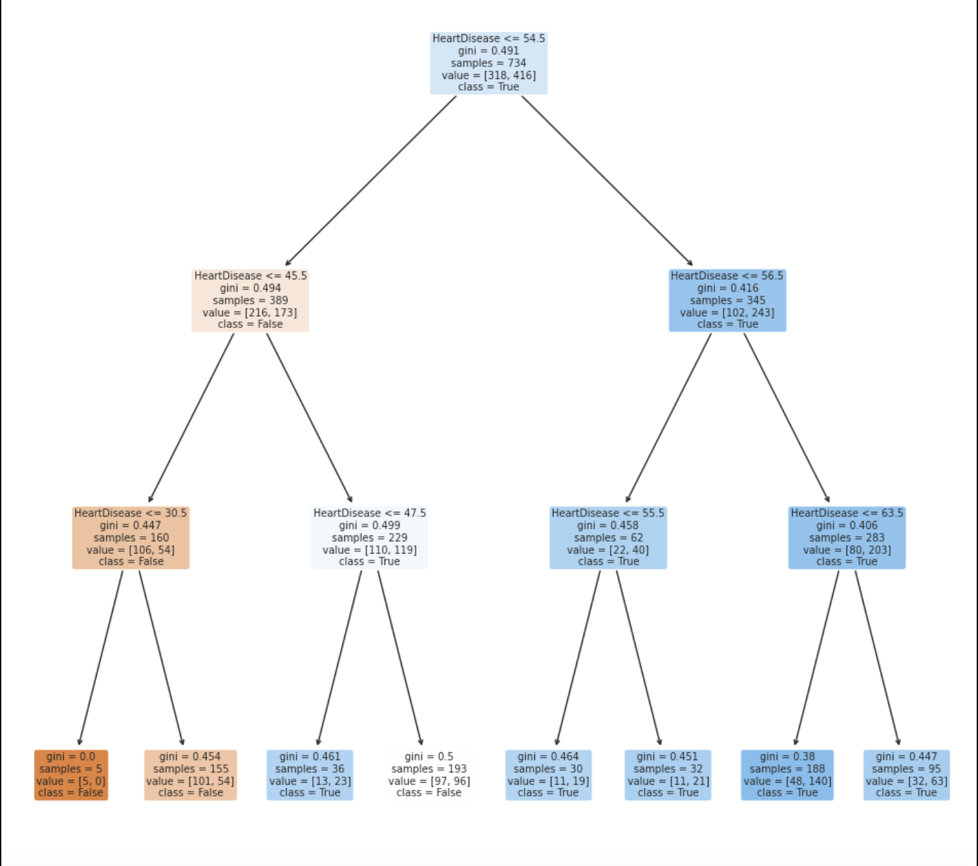
Decision Tree Model for MAXHR

Slide 29
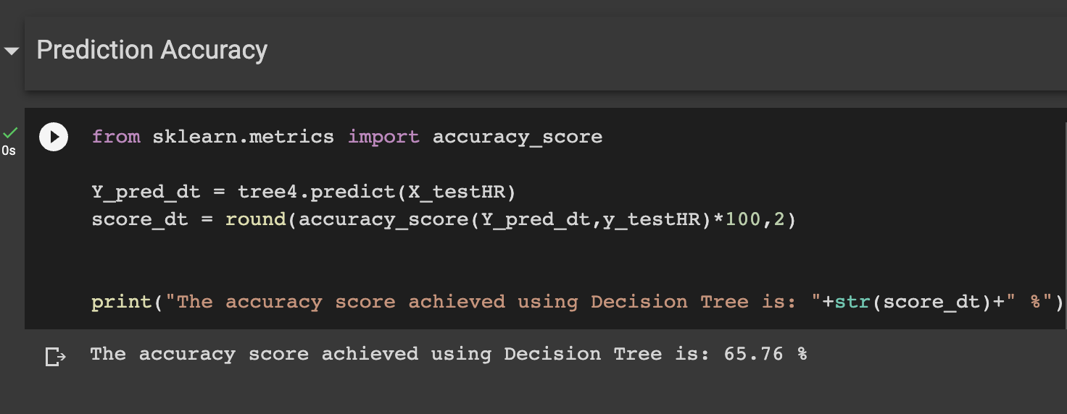
Decision Tree Model for MaxHR

Slide 30
02
Random Forest

Slide 31
How Random Forest Predicts
Chooses Random Sample From Dataset
Generate Model Based On This Random Sample
Final Output Dependent On Voting By All The Models

Slide 32
Why Use Random Forest
01
02
Less Prone to Noise
Highly Accurate
Not as affected by outliers
Much More Accurate than Decision Tree

Slide 33
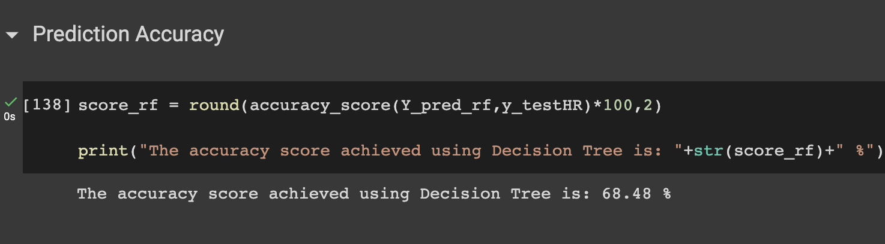
Random Forest Model For MaxHR

Slide 34
03
XGBoost

Slide 35
How XGBoost Predicts
Split data into training and test sets
Adds decision trees iteratively
Make final prediction

Slide 36
Why Use XGBoost
01
02
Highly Accurate
Able to Easily handle datasets
Combines multiple weak learners(decision trees)
Easily deals with large datasets

Slide 37
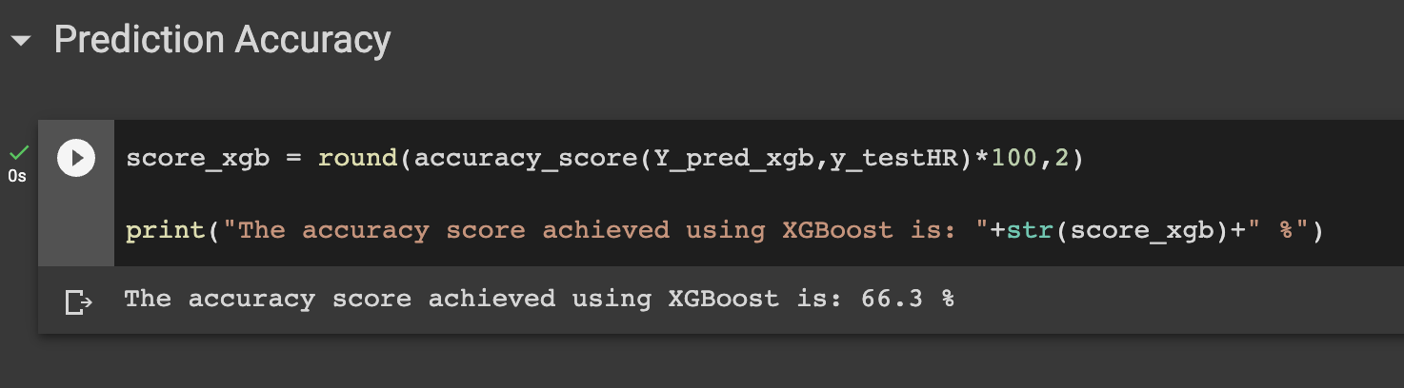
XGBoost Model For MaxHR

Slide 38
Conclusion
01 | Decision Tree
 | Accuracy | 65.76%
02 | Random Forest
 | Accuracy | 68.48%
03 | DATA PREPARATION
 | Accuracy | 66.3%
Which model is the best for predicting heart disease?

Slide 39
Conclusion
01 | Max HR
 | Accuracy | 68.48%
02 | Cholesterol
 | Accuracy | 54.89%
03 | Resting Blood Pressure
 | Accuracy | 46.2%
04 | DATA PREPARATION
 | Accuracy | 45.11%
Which indicator is the best for predicting heart disease

Slide 40
THANKS!
Please keep this slide for attribution

